Slide 1


Chapter 2
Switch Concepts and Configuration
Part II

Slide 2
Note for Instructors
These presentations are the result of a collaboration among the instructors at St. Clair College in Windsor, Ontario.
Thanks must go out to Rick Graziani of Cabrillo College. His material and additional information was used as a reference in their creation.
If anyone finds any errors or omissions, please let me know at:
  tdame@stclaircollege.ca.

Slide 3

Switch Concepts and Configuration
Configuring Switch Security
Console
MAC Address Flooding
Security Tools
Passwords
Telnet Attacks
Encryption
Spoofing Attacks
Port Security
CDP Attacks
Telnet / SSH
Password Recovery

Slide 4
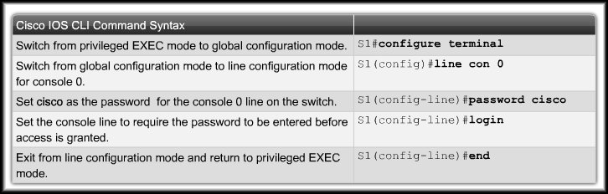
Configuring Password Options
Securing Console Access:

Slide 5
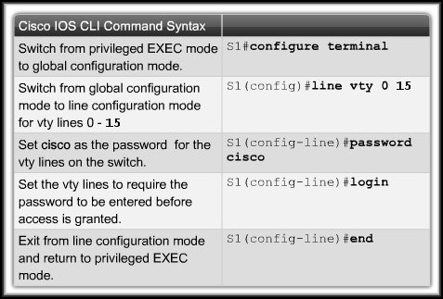
Configuring Password Options
Securing Virtual Terminal Access:
  There are 16 available default Telnet sessions as opposed to the 5 sessions set up for a router.

Slide 6
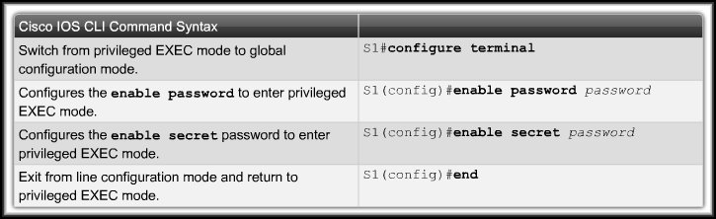
Configuring Password Options
Securing Privileged EXEC Access:
  Always use enable secret for password encryption.

Slide 7
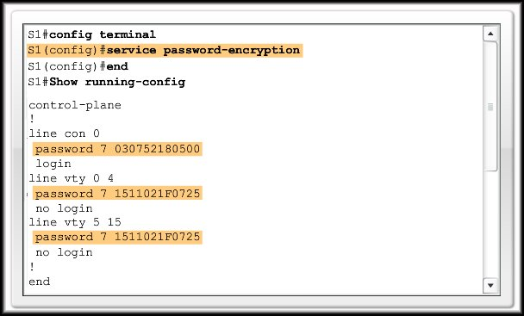
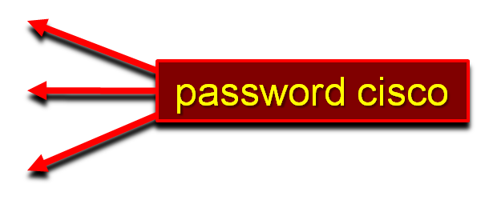
Configuring Password Options
Encrypting Switch Passwords:
  You can encrypt all passwords assigned to a switch using the service password-encryption command.

Slide 8
Configuring Password Options
Password Recovery:
  To recover a switch password:
    Power up the switch with the Mode button pressed.
    Initialize flash.
    Load helper files
    Rename the current configuration file.
    Reboot the system.
    Reinstate the name of the configuration file and copy it into RAM.
    Change the password.
    Copy to start up configuration
    Reload the switch.
A detailed password recovery procedure will be provided on Blackboard and in the lab.

Slide 9
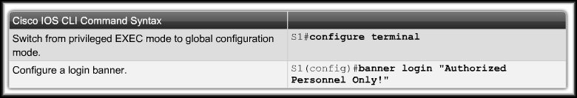
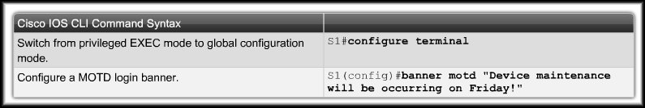
Login Banners
Login Banner:
Message-Of-The-Day (MOTD) Banner:

Slide 10
Configure Telnet and SSH
Telnet:
  Most common method.
  Virtual Terminal application.
  Send in clear text.
  Not secure.
Secure Shell (SSH):
  Virtual Terminal application.
  Sends an encrypted data stream.
  Is secure.

Slide 11
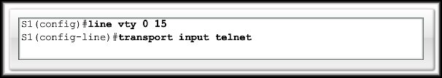
Configure Telnet and SSH
Configuring Telnet:
  Telnet is the default transport for the vty lines.
  No need to specify it after the initial configuration of the switch has been performed.
  If you have switched the transport protocol on the vty lines to permit only SSH, you need to enable the Telnet protocol to permit Telnet access.

Slide 12
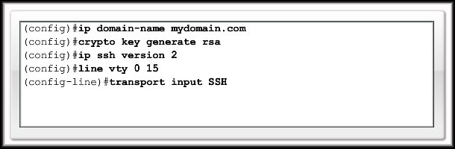
Configure Telnet and SSH
Configuring Secure Shell (SSH):
  SSH is a cryptographic security feature that is subject to export restrictions. To use this feature, a cryptographic image must be installed on your switch.
  Perform the following to configure SSH ONLY Access:

Slide 13
Common Security Attacks
MAC Address Flooding:
  Recall that the MAC address table in a switch:
    Contains the MAC addresses available on a given physical port of a switch.
    Contains the associated VLAN parameters for each.
    Is searched for the destination address of a frame.
      If it IS in the table, it is forwarded out the proper port.
      If it IS NOT in the table, the frame is forwarded out all ports of the switch except the port that received the frame.

Slide 14
Common Security Attacks
MAC Address Flooding:
  The MAC address table is limited in size.
  An intruder will use a network attack tool that continually sends bogus MAC addresses to the switch.
    (e.g. 155,000 MAC addresses per minute)
  The switch learns each bogus address and in a short span of time, the table becomes full.
  When a switch MAC table becomes full and stays full, it has no choice but to forward each frame it receives out of every port – just like a hub.
  The intruder can now see all the traffic on the switch.

Slide 15
Common Security Attacks
Spoofing Attacks:
  Man-In-The-Middle:
    Intercepting network traffic.
    DHCP or DNS spoofing.
    The attacking device responds to DHCP or DNS requests with IP configuration or address information that points the user to the intruder’s destination.
  DHCP Starvation:
    The attacking device continually requests IP addresses from a real DHCP server with continually changing MAC addresses.
    Eventually the pool of addresses is used up and actual users cannot access the network.

Slide 16
Common Security Attacks
CDP Attacks:
  Cisco Discovery Protocol (CDP) is a proprietary protocol that exchanges information among Cisco devices.
    IP address
    Software version
    Platform
    Capabilities
    Native VLAN (Trunk Links – Chapter 3).
  With a free network sniffer (Wireshark) an intruder could obtain this information.
  It can be used to find ways to perform Denial Of Service (DoS) attacks and others.
Usually on by default.
If you don’t need it, turn it off.

Slide 17
Common Security Attacks
Telnet Attacks:
  Recall that Telnet transmits in plain text and is not secure. While you may have set passwords, the following types of attacks are possible.
    Brute force (password guessing)
    DoS (Denial of Service)
    With a free network sniffer (Wireshark) an intruder could obtain this information.
    Use strong passwords and change them frequently.
    Use SSH.

Slide 18
Network Security Tools
Help you test your network for various weaknesses. They are tools that allow you to play the roles of a hacker and a network security analyst.
  Network Security Audits:
    Reveals what sort of information an attacker can gather simply by monitoring network traffic.
    Determine MAC address table limits and age-out period.
  Network Penetration Testing:
    Identify security weaknesses.
    Plan to avoid performance impacts.

Slide 19
Network Security Tools
Common Features:
  Service Identification:
    IANA port numbers, discover FTP and HTTP servers, test all of the services running on a host.
  Support of SSL Service:
    Testing services that use SSL Level security.
    HTTPS, SMTPS, IMAPS and security certificates.
  Non-destructive and Destructive Testing:
    Security audits that can degrade performance.
  Database of Vulnerabilities:
    Compile a database that can be updated over time.

Slide 20
Network Security Tools
You can use them to:
  Capture chat messages.
  Capture files from NFS traffic.
  Capture HTTP requests.
  Capture mail messages.
  Capture passwords.
  Display captured URLs in a browser in real-time.
  Flood a switched LAN with random MAC addresses.
  Forge replies to DNS addresses.
  Intercept packets.

Slide 21
Configuring Port Security
Implement Port Security to:
  Port security is disabled by default.
  Limit the number of valid MAC addresses allowed on a port.
  When you assign secure MAC addresses to a secure port, the port does not forward packets with source addresses outside the group of defined addresses.
    Specify a group of valid MAC addresses allowed on a port.
      Or Allow only one MAC address access to the port.
    Specify that the port automatically shuts down if an invalid MAC address is detected.

Slide 22
Configuring Port Security
Secure MAC Address types:
  Static:
    Manually specify that a specific MAC address is the ONLY address allowed to connect to that port.
    They are added to the MAC address table and stored in the running configuration.
  Dynamic:
    MAC addresses are learned dynamically when a device connects to the switch.
    They are stored in the address table and are lost when the switch reloads.

Slide 23
Configuring Port Security
Secure MAC Address types:
  Sticky:
    Specifies that MAC addresses are:
      Dynamically learned.
      Added to the MAC address table.
      Stored in the running configuration.
    You may also manually add a MAC address.
    MAC addresses that are “sticky learned” (you will hear that phrase) will be lost if you fail to save your configuration.

Slide 24
Configuring Port Security
Security Violation Modes:
  Violations occur when:
    A station whose MAC address is not in the address table attempts to access the interface and the address table is full.
    An address is being used on two secure interfaces in the same VLAN.
    Modes:
      Protect: drop frames – no notify
      Restrict: drop frames - notify
      Shutdown: disable port - notify

Slide 25
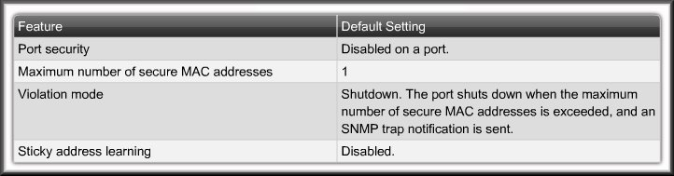
Configuring Port Security
Default Security Configuration:

Slide 26

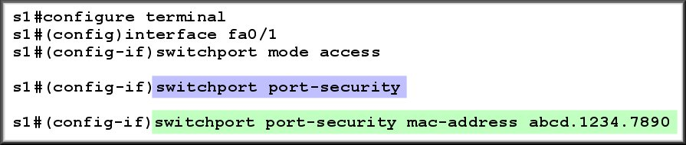


Configuring Port Security
Configure Static Port Security:
  ONLY address allowed.
  Add to MAC table and running configuration.

Slide 27
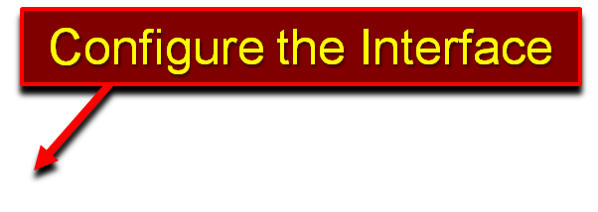
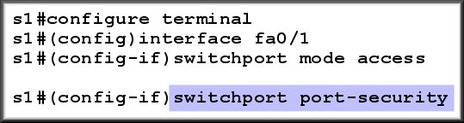

Configuring Port Security
Configure Dynamic Port Security:
  Dynamically learned when the device connects.
  Added to MAC table only.

Slide 28

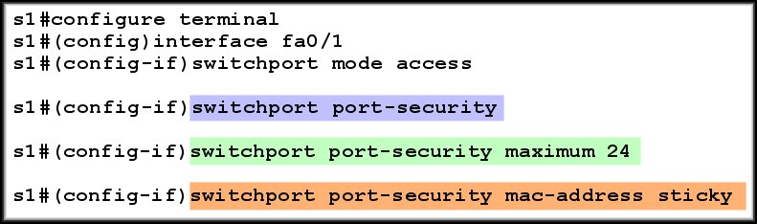


Configuring Port Security
Configure Sticky Port Security:
  Dynamically learn MAC addresses.
  Add to MAC table and running configuration.

Slide 29
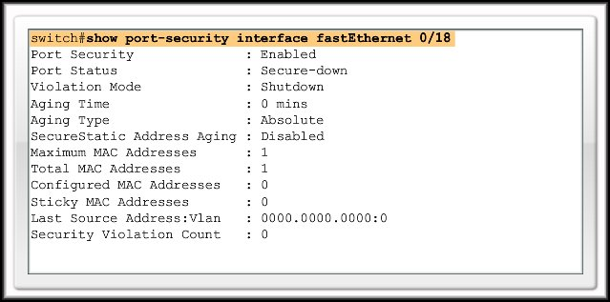
Verify Port Security
Verify Port Security Settings:

Slide 30
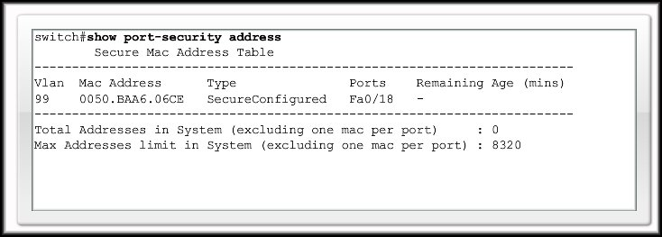
Verify Port Security
Verify Secure MAC Addresses:

Slide 31
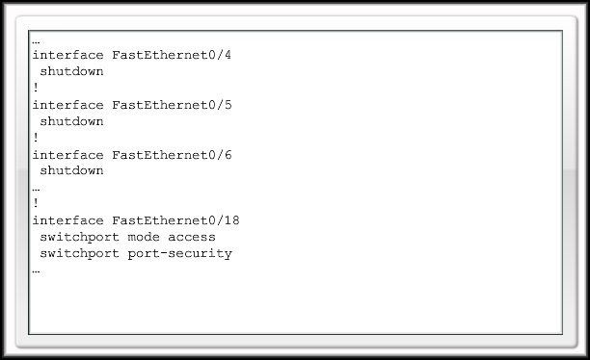
Securing Unused Ports
Disable unused ports:
You can specify a range of interfaces.
For example, to specify the first 10 interfaces:
interface range fastethernet 0/1 - 10

